Slide 1

Agenda
Design Patterns Overview
Sample : Singleton,Factory, Prototype , Facde , Abstract

Slide 2
OOP : What is Design pattern
Design pattern is a solution approach to a common problem, It should be an industry standard without language dependent
In software engineering, a design pattern is a general repeatable solution to a commonly occurring problem in software design
A design pattern isn’t a finished design that can be transformed directly into code.
It is a description or template for how to solve a problem that can be used in many different situations.

Slide 3
Examples of common problems solved by design pattern
How to instantiate an object properly
How to interact between two objects

Slide 4
Why
Design patterns are Solving recurring design problems
Software development design patterns were stated as best practices that were applied again and again to similar problems encountered in different contexts

Slide 5
Advantage :
can speed up the development process by providing tested, proven development paradigms.
Reusing the design patterns helps to prevent subtle issues that can cause major problems and it also improves code readability.
provides general solutions, documented in a format that doesn’t specifics tied to a particular problem.
In addition to that patterns allows developers to communicate well-known, well-understood names for software interactions,
Common design patterns can be improved over time, making them more robust than ad-hoc design.
A standard solution to a common programming problem enables large scale reuse of software.

Slide 6
History
Patterns originated as an architectural concept by Christopher Alexander (1977).
In 1994, four authors Erich Gamma, Richard Helm, Ralph Johnson and John Vlissides published a book titled Design Patterns - Elements of Reusable Object-Oriented Software which initiated the concept of Design Pattern in Software development.
These authors are collectively known as Gang of Four (GOF). According to these authors design patterns are primarily based on the following principles of object orientated design.
Program to an interface not an implementation
Favor object composition over inheritance

Slide 7
Creational Patterns :
These design patterns provides way to create a objects while hiding the creation logic, rather than instantiating the objects directly user new operator. This gives program more flexibility in deciding which objects needs to be created for a given Use case.
Creational design patterns are concerned with the way of creating objects. These design patterns are used when a decision must be made at the time of the instantiation of a class (i.e. creating an object of a class).
This pattern can be further divided into class-creation patterns and object-creational patterns. While class-creation patterns use inheritance effectively in the instantiation process, object-creation patterns use delegation effectively to get the job done.

Slide 8
Creational Patterns
Abstract Factory : create series of related or dependent objects without specifying their concrete classes. Usually created classes all implements same interface.
Static Factory : use just one static method to create all types of object it can create. It is usually named Factory or Build.
Factory method : creates objects without specifying the exact class to create.
Builder pattern : constructs complex object by separating construction and representation.
Prototype : pattern creates objects by cloning an existing objects.
Singleton : restricts object creation for a class to only one instance.

Slide 9
Singleton
Singleton pattern is one of the simplest design patterns in Java. This type of design pattern comes under creational pattern as this pattern provides one of the best ways to create an object.
This pattern involves a single class which is responsible to create an object while making sure that only single object gets created. This class provides a way to access its only object which can be accessed directly without need to instantiate the object of the class.

Slide 10
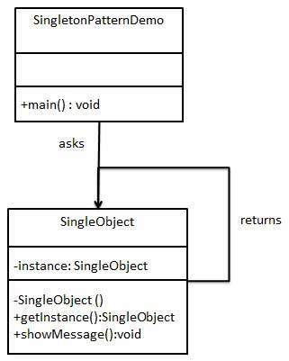
Singleton
Creational Patterns
Singleton Design Pattern.docx
We're going to create a SingleObject class. SingleObject class have its constructor as private and have a static instance of itself.
SingleObject class provides a static method to get its static instance to outside world. SingletonPatternDemo, our demo class will use SingleObject class to get a SingleObject object.

Slide 11
Factory
Factory pattern is one of the most used design patterns in Java. This type of design pattern comes under creational pattern as this pattern provides one of the best ways to create an object.
In Factory pattern, we create object without exposing the creation logic to the client and refer to newly created object using a common interface.

Slide 12
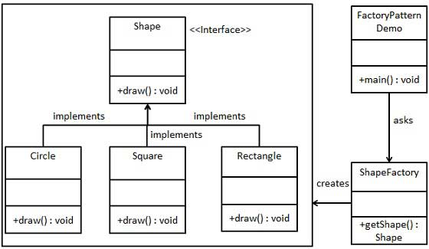
Factory Design Pattern
Creational Patterns
Factory Design Pattern.docx
We're going to create a Shape interface and concrete classes implementing the Shape interface. A factory class ShapeFactory is defined as a next step.
FactoryPatternDemo, our demo class will use ShapeFactory to get a Shape object. It will pass information (CIRCLE / RECTANGLE / SQUARE) to ShapeFactory to get the type of object it needs.

Slide 13
Prototype
Prototype pattern refers to creating duplicate object while keeping performance in mind. This type of design pattern comes under creational pattern as this pattern provides one of the best ways to create an object.
This pattern involves implementing a prototype interface which tells to create a clone of the current object. This pattern is used when creation of object directly is costly. For example, an object is to be created after a costly database operation. We can cache the object, returns its clone on next request and update the database as and when needed thus reducing database calls.

Slide 14
Abstract Factory
Abstract Factory patterns work around a super-factory which creates other factories. This factory is also called as factory of factories. This type of design pattern comes under creational pattern as this pattern provides one of the best ways to create an object.
In Abstract Factory pattern an interface is responsible for creating a factory of related objects without explicitly specifying their classes. Each generated factory can give the objects as per the Factory pattern.

Slide 15
Structural Patterns
Structural design patterns are concerned with how classes and objects can be composed, to form larger structures. The structural design patterns simplify the structure by identifying relationships.
These patterns focus on, how the classes inherit from each other and how they are composed of other classes.
These design patterns concern class and object composition. Concept of inheritance is used to compose interfaces and define way to compose objects to obtain new functionalities.

Slide 16
Structural Patterns
Adapter / Wrapper : translate one interface for a class into a compatible interface.
Bridge : Decouple an abstraction from its implementation so that two can vary independently.
Composite : treat a group of objects the same way as a single instance of the object.
Data Mapper : performs bidirectional transfer of data between a persistent data store (database) and an in memory data representation (domain).
Decorator : allows behavior to be added to an individual object without affecting the behavior of other objects from the same class.
Dependency Injection : implement a loosely coupled architecture in order to get better testable, maintainable and extendable code.

Slide 17
Structural Patterns
Facade : provides a simplified interface to a larger body of code, such as class library.
Fluent Interface : write code that is easily readable just like sentences in a natural language (like English).
Flyweight : instances of class which are identical are shared in an implementation instead of creating an new instance of that class of every instance.
Proxy : one class stands in for and handles all access to another class
Registry(Service locator pattern) : implement a central storage for objects often used throughout the application, is typically implemented using an abstract class with only static methods (or using Singleton Pattern).

Slide 18
Facade
Facade pattern hides the complexities of the system and provides an interface to the client using which the client can access the system. This type of design pattern comes under structural pattern as this pattern adds an interface to existing system to hide its complexities.
This pattern involves a single class which provides simplified methods required by client and delegates calls to methods of existing system classes.

Slide 19
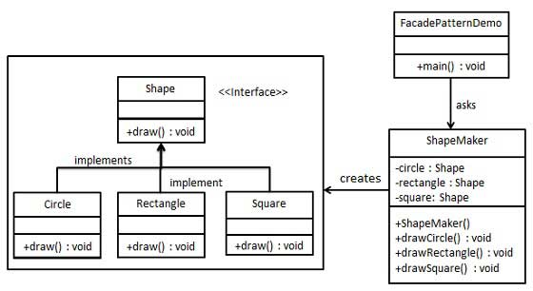
Facade
Structural Patterns
We are going to create a Shape interface and concrete classes implementing the Shape interface. A facade class ShapeMaker is defined as a next step.
ShapeMaker class uses the concrete classes to delegate user calls to these classes. FacadePatternDemo, our demo class, will use ShapeMaker class to show the results.

Slide 20
Adapter
Adapter pattern works as a bridge between two incompatible interfaces. This type of design pattern comes under structural pattern as this pattern combines the capability of two independent interfaces.
This pattern involves a single class which is responsible to join functionalities of independent or incompatible interfaces. A real life example could be a case of card reader which acts as an adapter between memory card and a laptop. You plugin the memory card into card reader and card reader into the laptop so that memory card can be read via laptop.
We are demonstrating use of Adapter pattern via following example in which an audio player device can play mp3 files only and wants to use an advanced audio player capable of playing vlc and mp4 files.

Slide 21
Adapter
Structural Patterns
WebToBookAdapter
interface iPublish
{
public void showDetails();
}
WebView
LibBook
interface iWebhost
{
public void onCall();
}
interface iView
{
public void sendData();
}

Slide 22
Bridge
Bridge is used when we need to decouple an abstraction from its implementation so that the two can vary independently. This type of design pattern comes under structural pattern as this pattern decouples implementation class and abstract class by providing a bridge structure between them.
This pattern involves an interface which acts as a bridge which makes the functionality of concrete classes independent from interface implementer classes. Both types of classes can be altered structurally without affecting each other.
We are demonstrating use of Bridge pattern via following example in which a circle can be drawn in different colors using same abstract class method but different bridge implementer classes.

Slide 23
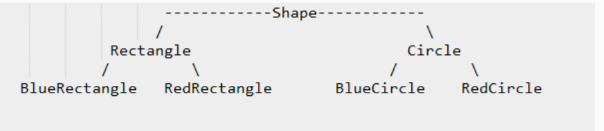
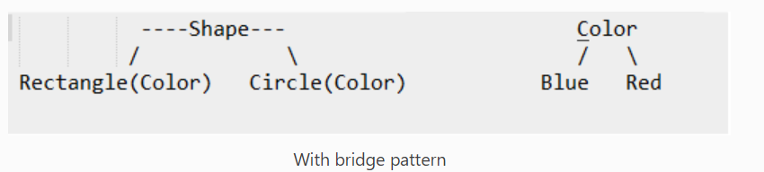
Bridge
Structural Patterns

Slide 24
Composite
Composite pattern is used where we need to treat a group of objects in similar way as a single object. Composite pattern composes objects in term of a tree structure to represent part as well as whole hierarchy. This type of design pattern comes under structural pattern as this pattern creates a tree structure of group of objects.
This pattern creates a class that contains group of its own objects. This class provides ways to modify its group of same objects.

Slide 25
Composite Pattern
Structural Patterns

Slide 26
Decorator
Decorator pattern allows a user to add new functionality to an existing object without altering its structure. This type of design pattern comes under structural pattern as this pattern acts as a wrapper to existing class.
This pattern creates a decorator class which wraps the original class and provides additional functionality keeping class methods signature intact.
We are demonstrating the use of decorator pattern via following example in which we will decorate a shape with some color without alter shape class.

Slide 27
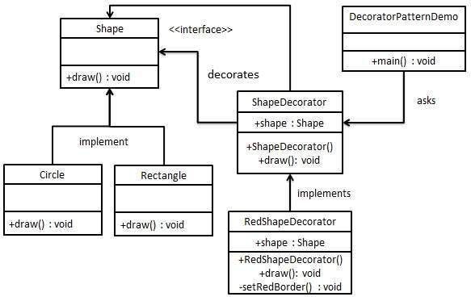
Decorator
Structural Patterns
We're going to create a Shape interface and concrete classes implementing the Shape interface. We will then create an abstract decorator class ShapeDecorator implementing the Shape interface and having Shape object as its instance variable.
RedShapeDecorator is concrete class implementing ShapeDecorator.
DecoratorPatternDemo, our demo class will use RedShapeDecorator to decorate Shape objects.

Slide 28
Flyweight
Flyweight pattern is primarily used to reduce the number of objects created and to decrease memory footprint and increase performance. This type of design pattern comes under structural pattern as this pattern provides ways to decrease object count thus improving the object structure of application.
Flyweight pattern tries to reuse already existing similar kind objects by storing them and creates new object when no matching object is found. We will demonstrate this pattern by drawing 20 circles of different locations but we will create only 5 objects. Only 5 colors are available so color property is used to check already existing Circle objects.

Slide 29
Flyweight
Structural Patterns

Slide 30
Proxy
In proxy pattern, a class represents functionality of another class. This type of design pattern comes under structural pattern.
In proxy pattern, we create object having original object to interface its functionality to outer world.

Slide 31
Proxy
Structural Patterns

Slide 32
Behavioral Patterns
These design patterns are specifically concerned with communication between objects.
Behavioral design patterns are concerned with the interaction and responsibility of objects. In these design patterns, the interaction between the objects should be in such a way that they can easily talk to each other and still should be loosely coupled.
That means the implementation and the client should be loosely coupled to avoid hard coding and dependencies.

Slide 33
Behavior Patterns
Chain of Responsibilities : build a chain of objects to handle a call in a sequential order.
Command : an object is used to encapsulate all information needed to perform an action or trigger an event at a later time.
Iterator : make an object Iterable and to make it appear like a collection of objects.
Mediator : easy way to decouple many components working together.
Memento : provides the ability of restore an object to its previous state (undo via rollback) or to gain access to state of the object, without revealing it’s implementation.
Null object : not a GOF design pattern, but a schema which appears frequently enough to be considered a pattern.

Slide 34
Behavioral Patterns
Observer : implement publish/subscribe behavior to an object, When ever Subject object changes its state the attached Observers will be notified
Specification : separate the statement of how to match a candidate, from the candidate object that it is matched against.
State : implements a state machine in a object-oriented way.
Visitor : lets you outsource operations on objects to other objects.
Strategy : separate strategies and to enable fast switching between them.
Template method : one or more algorithm steps can be overridden by subclasses to allow differing behaviors while ensuring that the overarching algorithm is still followed.

Slide 35
Chain of responsibility
As the name suggests, the chain of responsibility pattern creates a chain of receiver objects for a request. This pattern decouples sender and receiver of a request based on type of request. This pattern comes under behavioral patterns.
In this pattern, normally each receiver contains reference to another receiver. If one object cannot handle the request then it passes the same to the next receiver and so on.

Slide 36
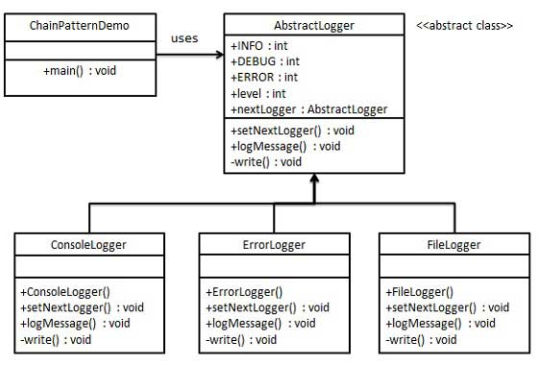
Chain of Responsibility : Vending Machine with single coin slot
We have created an abstract class AbstractLogger with a level of logging. Then we have created three types of loggers extending the AbstractLogger. Each logger checks the level of message to its level and print accordingly otherwise does not print and pass the message to its next logger.
Behavioral Patterns

Slide 37
Command
Command pattern is a data driven design pattern and falls under behavioral pattern category. A request is wrapped under an object as command and passed to invoker object. Invoker object looks for the appropriate object which can handle this command and passes the command to the corresponding object which executes the command.

Slide 38
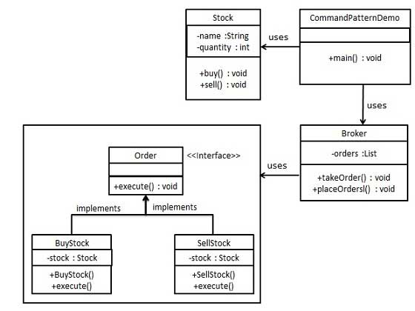
Command : The “check” at a dinner
Behavioral Patterns
We have created an interface Order which is acting as a command. We have created a Stock class which acts as a request. We have concrete command classes BuyStock and SellStock implementing Order interface which will do actual command processing. A class Broker is created which acts as an invoker object. It can take and place orders.
Broker object uses command pattern to identify which object will execute which command based on the type of command. CommandPatternDemo, our demo class, will use Broker class to demonstrate command pattern.

Slide 39
Iterator
Iterator pattern is very commonly used design pattern in Java and .Net programming environment. This pattern is used to get a way to access the elements of a collection object in sequential manner without any need to know its underlying representation.
Iterator pattern falls under behavioral pattern category.

Slide 40
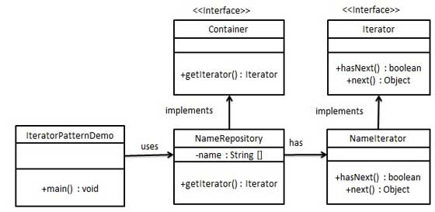
Iterator : TV Remote Control
Behavioral Patterns
We're going to create a Iterator interface which narrates navigation method and a Container interface which retruns the iterator . Concrete classes implementing the Container interface will be responsible to implement Iterator interface and use it
IteratorPatternDemo, our demo class will use NamesRepository, a concrete class implementation to print a Names stored as a collection in NamesRepository.

Slide 41
Mediator
Mediator pattern is used to reduce communication complexity between multiple objects or classes. This pattern provides a mediator class which normally handles all the communications between different classes and supports easy maintenance of the code by loose coupling. Mediator pattern falls under behavioral pattern category.

Slide 42
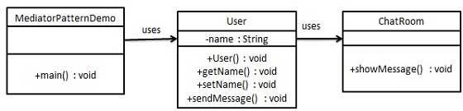
Mediator : ATC Mediator
Behavioral Patterns
We are demonstrating mediator pattern by example of a chat room where multiple users can send message to chat room and it is the responsibility of chat room to show the messages to all users. We have created two classes ChatRoom and User. User objects will use ChatRoom method to share their messages.
MediatorPatternDemo, our demo class, will use User objects to show communication between them.

Slide 43
Memento
Memento pattern is used to restore state of an object to a previous state. Memento pattern falls under behavioral pattern category.

Slide 44
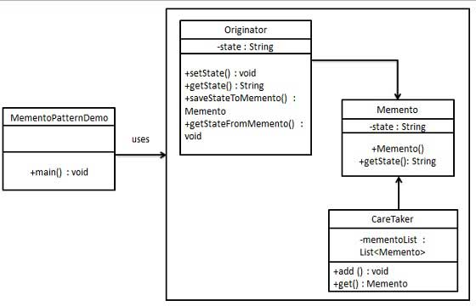
Memento : Ctrl +Z
Behavioral Patterns
Memento pattern uses three actor classes. Memento contains state of an object to be restored. Originator creates and stores states in Memento objects and Caretaker object is responsible to restore object state from Memento. We have created classes Memento, Originator and CareTaker.
MementoPatternDemo, our demo class, will use CareTaker and Originator objects to show restoration of object states.

Slide 45
Observer
Observer pattern is used when there is one-to-many relationship between objects such as if one object is modified, its dependent objects are to be notified automatically. Observer pattern falls under behavioral pattern category.

Slide 46
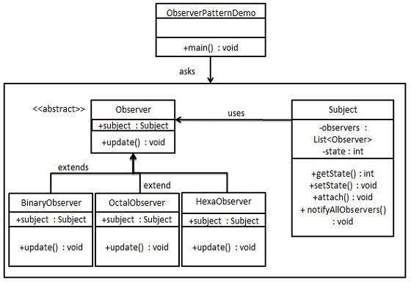
Observer Pattern : Stock market ticker
Behavioral Patterns
Observer pattern uses three actor classes. Subject, Observer and Client. Subject is an object having methods to attach and detach observers to a client object. We have created an abstract class Observer and a concrete class Subject that is extending class Observer.
ObserverPatternDemo, our demo class, will use Subject and concrete class object to show observer pattern in action.

Slide 47
State
In State pattern a class behavior changes based on its state. This type of design pattern comes under behavior pattern.
In State pattern, we create objects which represent various states and a context object whose behavior varies as its state object changes.

Slide 48
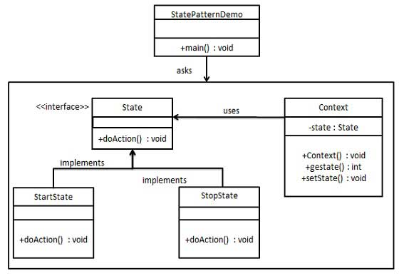
State : Vending machine
Behavioral Patterns
We are going to create a State interface defining an action and concrete state classes implementing the State interface. Context is a class which carries a State.
StatePatternDemo, our demo class, will use Context and state objects to demonstrate change in Context behavior based on type of state it is in.

Slide 49
Null Object
In Null Object pattern, a null object replaces check of NULL object instance. Instead of putting if check for a null value, Null Object reflects a do nothing relationship. Such Null object can also be used to provide default behavior in case data is not available.
In Null Object pattern, we create an abstract class specifying various operations to be done, concrete classes extending this class and a null object class providing do nothing implemention of this class and will be used seamlessly where we need to check null value.

Slide 50
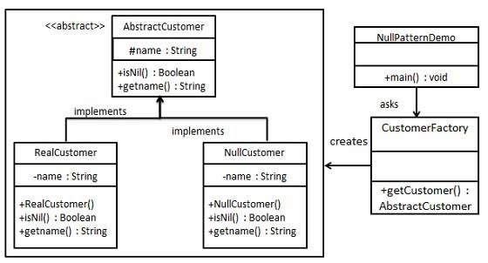
Null Object
Behavioral Patterns
We are going to create a AbstractCustomer abstract class defining opearations. Here the name of the customer and concrete classes extending the AbstractCustomer class. A factory class CustomerFactory is created to return either RealCustomer or NullCustomer objects based on the name of customer passed to it.
NullPatternDemo, our demo class, will use CustomerFactory to demonstrate the use of Null Object pattern.

Slide 51
Strategy
In Strategy pattern, a class behavior or its algorithm can be changed at run time. This type of design pattern comes under behavior pattern.
In Strategy pattern, we create objects which represent various strategies and a context object whose behavior varies as per its strategy object. The strategy object changes the executing algorithm of the context object.

Slide 52
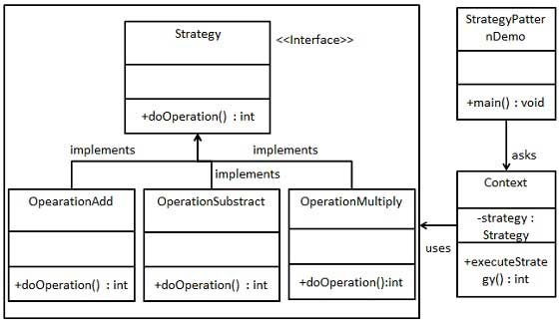
Strategy : Mode of transportation to airport
Behavioral Patterns
We are going to create a Strategy interface defining an action and concrete strategy classes implementing the Strategy interface. Context is a class which uses a Strategy.
StrategyPatternDemo, our demo class, will use Context and strategy objects to demonstrate change in Context behaviour based on strategy it deploys or uses.

Slide 53
Interpreter
The Interpreter pattern is used to define a grammar for interpreting certain expressions and provides an interpreter to interpret those expressions

Slide 54
Template
In Template pattern, an abstract class exposes defined way(s)/template(s) to execute its methods. Its subclasses can override the method implementation as per need but the invocation is to be in the same way as defined by an abstract class. This pattern comes under behavior pattern category.

Slide 55
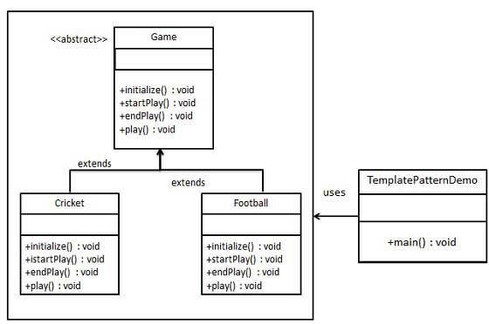
Template : Basic Floor Plan
Behavioral Patterns
We are going to create a Game abstract class defining operations with a template method set to be final so that it cannot be overridden. Cricket and Football are concrete classes that extend Game and override its methods.
TemplatePatternDemo, our demo class, will use Game to demonstrate use of template pattern.

Slide 56
Visitor
In Visitor pattern, we use a visitor class which changes the executing algorithm of an element class. By this way, execution algorithm of element can vary as and when visitor varies. This pattern comes under behavior pattern category. As per the pattern, element object has to accept the visitor object so that visitor object handles the operation on the element object.

Slide 57
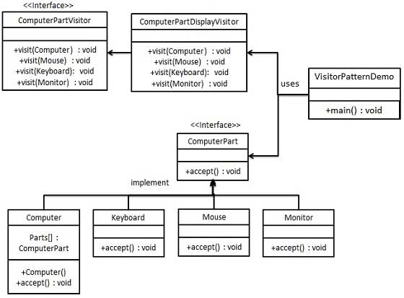
Visitor : Operation of taxi company
Behavioral Patterns
We are going to create a ComputerPart interface defining accept opearation. Keyboard, Mouse, Monitor and Computer are concrete classes implementing ComputerPart interface. We will define another interface ComputerPartVisitor which will define a visitor class operations. Computer uses concrete visitor to do corresponding action.
VisitorPatternDemo, our demo class, will use Computer and ComputerPartVisitor classes to demonstrate use of visitor pattern.

Slide 58
Conclusion
Its not necessary to implement all of the design patterns in your software development, though you can leverage the appropriate design patterns to your problems in software development.
As mentioned design patterns are an implemented and tested solution, so if necessary you could design your own design pattern.

